Slide 1
File Handling – FILE I/O Overview
Carole McGloughlin
Frances Sheridan

Slide 2
FILE I/O
Over the next two weeks we will look at FILE I/O (File Input and Output) for:
Text
Objects
Text and Objects are dealt with in slightly different ways.
The following slides are an overview of Text File Handling
There are many ways to do FILE I/O in Java – the worked examples (in the following sets of slides) are the methods that we will employ for reading and writing text to a file.
The rest is supplementary information, that you should be aware of.

Slide 3
Java Input Output (I/O) Streams
An I/O Stream represents an input source or an output destination.
A stream can represent many different kinds of sources and destinations,
Disk files, devices, other programs, a network socket, and memory arrays.
Streams support many different kinds of data,
Simple bytes, primitive data types, localised characters, and objects.
Some streams simply pass on data; others manipulate and transform the data in useful ways.
No matter how they work internally, all streams present the same simple model to programs that use them,
A stream is a sequence of data.
Streams may be Input, Output, Character, Byte, Unbuffered or Buffered.

Slide 4
Input & Output Streams
All input and output in Java is accomplished by classes called Streams.
Input Streams provide ways to read data from an input device to a programme one item at a time,
Output Streams write the data one item at a time in the opposite direction,
Devices may represent a variety of source or destination points e.g. disk files, devices, other programs, a network socket, and memory arrays.
Input Stream
Programme
Device
Output Stream
Programme
Device

Slide 5
Character & Byte Streams
Java distinguishes between 2 types of streams,
Character streams, containing an 8-bit superset of ASCII text (for western locals),
Byte streams, containing 8 – bit binary information,
Programme
I
a
m
a
s
t
r
i
n
g
Device
Programme
10101010
10010100
01101001
Device

Slide 6
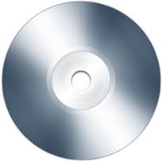
Unbuffered & Buffered Streams
The Java platform implements Buffered I/O Streams to reduce the overhead experienced by Unbuffered I/O,
Buffered input streams read data from a memory area known as a buffer; the native input API is called only when the buffer is empty.
Similarly, buffered output streams write data to a buffer, and the native output API is called only when the buffer is full.
Unbuffered I/O Streams, each read or write request is handled directly by the underlying Operating System (OS).
Much less efficient, since each request often triggers disk access, network activity, or some other operation that is relatively expensive.
Programme
Programme
buffer
1
0
0
0
1
1
0
1
1
0
0

Slide 7
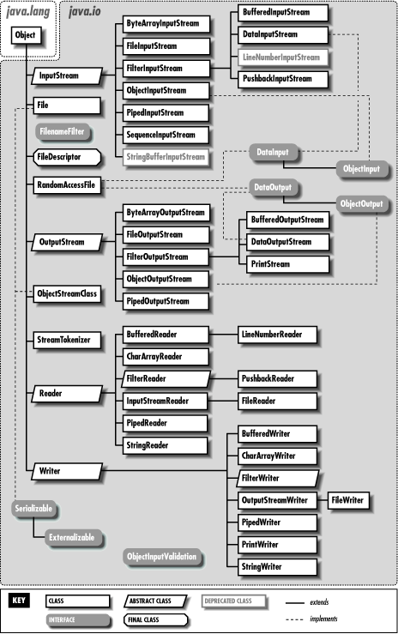
Java I/O Class Diagram
Byte Stream
InputStream
OutputStream
Character Stream
Reader
Writer

Slide 8
InputStream vs. Reader Classes
InputStream | Reader | Description
void close() | abstract void close() | Closes this stream and releases any system resources associated with the stream.
void mark(int readlimit) | void mark(int readAheadLimit) | Marks the present position in the stream.
abstract int read() | int read() | Reads the next byte of data / single character from the stream.
int read(byte[] b) | int read(char[] cbuf) | Reads some number of bytes from the input stream and stores them into the buffer array b / Reads characters into an array cbuf.
int read(byte[] b, int off, int len) | abstract int read(char[] cbuf, int off, int len) | Reads up to len bytes of data from the input stream into an array of bytes / Reads characters into a portion of an array.
void reset() | void reset() | Repositions this stream to the position at the time the mark method was last called on this input stream / Resets the stream.
long skip(long n) | long skip(long n) | Skips over and discards n bytes of data from this input stream / Skips characters.
References:
http://docs.oracle.com/javase/7/docs/api/java/io/InputStream.html
http://docs.oracle.com/javase/7/docs/api/java/io/Reader.html

Slide 9
OutputStream vs. Writer Classes
InputStream | Reader | Description
void close() | abstract void close() | Closes this output stream and releases any system resources associated with this stream / Closes the stream, flushing it first.
void flush() | void flush() | Flushes this output stream and forces any buffered output bytes to be written out.
abstract void write(int b) | void write(int c) | Writes the specified byte to this output stream / Writes a single character.
void write(byte[] b) | void write(char[] cbuf) | Writes b.length bytes from the specified byte array to this output stream / Writes an array of characters, cbuf.
void write(byte[] b, int off, int len) | abstract void write(char[] cbuf, int off, int len) | Writes len bytes from the specified byte array starting at offset off to this output stream / Writes a portion of an array of characters.
References:
http://docs.oracle.com/javase/7/docs/api/java/io/OutputStream.html
http://docs.oracle.com/javase/7/docs/api/java/io/Writer.html

Slide 10
Byte Stream
Byte Stream in Context
Using Byte Streams
Byte Stream Example

Slide 11
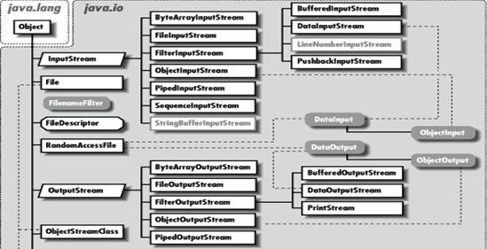
Byte Stream in Context
Programs use byte streams to perform input and output of 8-bit bytes.
All byte stream classes are descended from InputStream and OutputStream.
There are many byte stream classes,
FileInputStream and FileOutputStream.
They are used in much the same way; they differ mainly in the way they are constructed.

Slide 12
Using Byte Streams
A Byte Stream represents a kind of low-level I/O that you should avoid where an alternative is available,
If the data contains character data, the best approach is to use character streams.
There are also streams for more complicated data types.
All other streams are based on byte stream.
Byte streams represents the most primitive I/O type.

Slide 13
Byte Stream Example
Create a new NetBeans project called, ByteStreamApp.
Use FileInputStream & FileOutputStream to preform a file byte copy,
public class ByteStreamApp {
public static void main(String[] args) throws IOException {
FileInputStream in = null;
FileOutputStream out = null;
in = new FileInputStream("build.xml");
out = new FileOutputStream("build-byte-copy.xml");
int fileByte;
while ((fileByte = in.read()) != -1) {
out.write(fileByte);
}
if (in != null) {
in.close();
}
if (out != null) {
out.close();
}
}
}
T
h
e
b
r
o
w
n
f
o
x
fileByte = in.read()
out.write(fileByte)
T
h
e
b
r
o
w

Slide 14
Character Stream
Byte Stream Context
Using Character Streams
Byte Stream Example

Slide 15
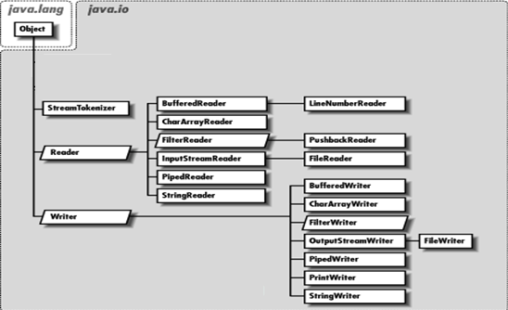
Character Stream in Context
The Java platform stores character values using Unicode conventions
Character stream I/O automatically translates this internal format to and from the local character set.
In Western locales, the local character set is usually an 8-bit superset of ASCII.
All character stream classes are descended from Reader and Writer
As with byte streams, there are character stream classes that specialise in file I/O,
FileReader and FileWriter.

Slide 16
Using Character Streams
For most applications, I/O with character streams is no more complicated than I/O with byte streams,
Input and output done with stream classes automatically translates to and from the local character set.
A program that uses character streams in place of byte streams automatically adapts to the local character set and is ready for internationalisation — all without extra effort by the programmer.
If internationalisation isn't a priority, you can simply use the character stream classes without paying much attention to character set issues.
Later, if internationalisation becomes a priority, your program can be adapted without extensive recoding.

Slide 17
Character Stream Example
Create a new NetBeans project called, CharacterStreamApp.
Use FileReader & FileWriter to preform a file character based copy,
public class CharacterStreamApp {
public static void main(String[] args) throws IOException {
FileReader in = null;
FileWriter out = null;
in = new FileReader("build.xml");
out = new FileWriter("build-char-copy.xml");
int fileChar;
while ((fileChar = in.read()) != -1) {
out.write(fileChar);
}
if (in != null) {
in.close();
}
if (out != null) {
out.close();
}
}
T
h
e
b
r
o
w
n
f
o
x
fileChar = in.read()
out.write(fileChar)
T
h
e
b
r
o
w

Slide 18
Buffered Stream
Buffered Streams in Context
Combining & Wrapping Streams
Line-Oriented I/O
Combining Streams for Line-Oriented I/O

Slide 19
Buffered Streams in Context
There are four buffered stream classes used to wrap unbuffered streams:
BufferedInputStream and BufferedOutputStream create buffered byte streams; and
BufferedReader and BufferedWriter create buffered character streams.

Slide 20
Combining & Wrapping Streams
Streams may be combined into chains to achieve more advanced input and output operations.
For instance, reading every byte one at a time from a file is slow,
It is faster to read a larger block of data from the disk and then iterate through that block byte for byte afterwards.
To achieve buffering you can wrap your InputStream in an BufferedInputStream, for example,
Above a byte oriented FileInputStream is wrapped by the BufferedInputStream.
Buffering can also be applied to OutputStream's thereby batching the writes to disk (or the underlying stream device) up in larger chunks. That provides faster output too.
InputStream input = new BufferedInputStream(new FileInputStream("build.xml"));

Slide 21
Line-Oriented I/O
Character I/O usually occurs in bigger units than single characters.
One common unit is the line: a string of characters with a line terminator at the end.
A line terminator depends on the OS and can be a,
Carriage-return/line-feed sequence ("\r\n");
Single carriage-return ("\r"); or
Single line-feed ("\n").

Slide 22
Combining Streams for Line-Oriented I/O
Create a new NetBeans project called, LineIOApp.
Using
FileReader wrapped in a BufferedReader; and
FileWriter wrapped in a PrintWriter.
public static void main(String[] args) throws IOException {
File inputFile = new File("build.xml");
File outputFile = new File("build-line-copy.xml");
FileReader in = new FileReader(inputFile);
FileWriter out = new FileWriter(outputFile);
BufferedReader inputStream = new BufferedReader(in);
PrintWriter outputStream = new PrintWriter(out);
String line;
while ((line = inputStream.readLine()) != null) {
System.out.println(line);
outputStream.println(line);
}
if (in != null) {in.close();}
if (out != null) { out.close();}
}

Slide 23
Flushing Buffered Streams
It often makes sense to write out a buffer at critical points, without waiting for it to fill. This is known as flushing the buffer.
Some buffered output classes support auto flush, specified by an optional constructor argument.
When auto flush is enabled, certain key events cause the buffer to be flushed.
For example, an auto flush PrintWriter object flushes the buffer on every invocation of println or format, PrintWriter(Writer out, boolean autoFlush);.
To flush a stream manually, invoke its flush method, void flush();.
The flush method is valid on any output stream, but has no effect unless the stream is buffered.

Slide 24
Standard Streams
Predefined Standard Streams

Slide 25
Predefined Standard Streams
System.in
InputStream object, usually for the keyboard
System.out
a buffered PrintStream object, usually the screen or an active window
System.err
an unbuffered PrintStream object usually associated with the screen or console window

Slide 26
Data Streams
DataOutputStream
DataInputStream Example
DataInputStream Example

Slide 27
Data Streams in Context
Data streams support binary I/O of primitive data type values only e.g. boolean, char, byte, short, int, long, float, double etc. as well as String values.
All data streams implement either the DataInput interface or the DataOutput interface.
DataInputStream and DataOutputStream are most widely-used implementations of these interfaces.

Slide 28
DataOutputStream Example
Create a new NetBeans project called, DataStreamApp,
Use DataOutputStream to write several arrays of primitive data types,
public static void main(String[] args) throws IOException {
// Set up the data to write
String[] titles = { "An Introduction to OOP with Java", "How to Program in Java",
"Java The Complete Reference Book", "Head First Java"};
int[] dates = { 2001, 2007, 2005, 2550};
int[] quantities = { 5, 2, 3, 1};
boolean[] itemsInStock = { true, true, false, true};
double[] prices = { 118.74, 118.35, 37.80, 28.01};
// Open the DataOutputStream to write the data
DataOutputStream out = new DataOutputStream(new BufferedOutputStream(new FileOutputStream("books.txt")));
// Write the data
for (int index = 0; index < titles.length; index ++) {
out.writeUTF(titles[index]);
out.writeInt(dates[index]);
out.writeInt(quantities[index]);
out.writeBoolean(itemsInStock[index]);
out.writeDouble(prices[index]);
}
if (out != null) { out.close(); }
}
UCS (Universal Character Set) Transformation Format (UTF)

Slide 29
DataInputStream Example
Extend the DataStreamApp to read back the data from the file.
Like DataOutputStream, DataInputStream must be constructed as a wrapper for a byte stream.
End-of-file condition is detected by catching EOFException, instead of testing for an invalid return value.

Slide 30
DataInputStream Example
Use DataInputStream to read primitive data types from a file,
public static void main(String[] args) throws IOException {
…
// Set up the data to write
String title;
int date;
int quantity;
boolean itemInStock;
double price;
// Open the DataInputStream to read the data
DataInputStream in = new DataInputStream(new BufferedInputStream(new FileInputStream("books.txt")));
try {
// Read the data and display on the console
while (true) {
title = in.readUTF();
date = in.readInt();
quantity = in.readInt();
itemInStock = in.readBoolean();
price = in.readDouble();
if(itemInStock) {
System.out.println("Book: " + title + " (" + date + "), "+ quantity + " in stock. Price €" + price);
} else {
System.out.println("Book: " + title + " (" + date + "), "+ quantity + " on back order. Price €" + price);
}
}
}
catch (EOFException ex) { // Notice that DataStreams detects an end-of-file condition by catching EOFException,
// instead of testing for an invalid return value.
if (out != null) { out.close(); }
System.out.println("Complete");
System.out.println("Working Directory = " + System.getProperty("user.dir"));
}
}

Slide 31
Object Streams, Serialisation & Deserialisation
Object Streams
Object Stream Example
Object Serialisation
Object Deserialisation

Slide 32
Object Streams
Object streams support I/O of objects,
Like Data streams support I/O of primitive data types.
The object has to be Serializable type.
The object stream classes are ObjectInputStream to read an object and ObjectOutputStream to write an object,
These classes implement ObjectInput and ObjectOutput, which are subinterfaces of DataInput and DataOutput.
An object stream can contain a mixture of primitive and object values.

Slide 33
Object Stream Example
The writeObject traverses the entire class hierarchy of object references and writes all objects in that hierarchy onto the stream
A single invocation of writeObject can cause a large number of objects to be written to the stream,
When an instance of the Book class is written by writeObject, the super class, StockItem is written automatically as well (if Serializable) – this is Serialisation.
When a Book object is read by readObject, all associated Serializable objects are read back as well, and all the original object references are preserved – this is Deserialisation.
out.writeObject(book)
book = (Book)in.readObject();
Book
Book
StockItem
StockItem

Slide 34
Object Serialisation
import java.io.FileOutputStream;
import java.io.ObjectOutputStream;
import java.io.FileInputStream;
import java.io.ObjectInputStream;
import java.io.IOException;
import java.io.EOFException;
public static void serialize() throws IOException {
Book book1 = new Book( "An Introduction to OOP ", 2001,
5, true, 118.74);
Book book2 = new Book( "How to Program in Java", 2007,
2, true, 118.35);
Book book3 = new Book( "Java Complete Reference”, 2005, 3, false, 37.80);
Book book4 = new Book( "Head First Java", 2005,
1, true, 28.01);
ObjectOutputStream out = new ObjectOutputStream(
new FileOutputStream(fileName));
out.writeObject(book1);
out.writeObject(book2);
out.writeObject(book3);
out.writeObject(book4);
out.close();
}
import java.io.Serializable;
public class Book extends StockItem implements Serializable {
public String title; // Book title
public int date; // published year
public Book(String title, int date,
int quantity, boolean inStock, double price) {
…
}
}
import java.io.Serializable;
public class StockItem implements Serializable {
public int quantity; // quantity in stock
public boolean inStock; // true in stock; false otherwise
public double price; // unit price in euro
public StockItem(int quantity, boolean inStock, double price) {
…
}
}

Slide 35
Object Deserialisation
import java.io.FileOutputStream;
import java.io.ObjectOutputStream;
import java.io.FileInputStream;
import java.io.ObjectInputStream;
import java.io.IOException;
import java.io.EOFException;
public static void deserialize()
throws IOException, ClassNotFoundException {
ObjectInputStream in = new ObjectInputStream(
new FileInputStream(fileName));
try {
Book book = null;
// Read the data and display on the console
while (true) {
book = (Book)in.readObject();
System.out.println(book.toString());
}
}
catch (EOFException ex) { // Notice that ObjectInputStream // detects an end-of-file condition
// by catching EOFException,
// instead of testing for an invalid
// return value.
if (in != null) { in.close(); }
}
}
import java.io.Serializable;
public class Book extends StockItem implements Serializable {
public String title; // Book title
public int date; // published year
public Book(String title, int date,
int quantity, boolean inStock, double price) {
…
}
}
import java.io.Serializable;
public class StockItem implements Serializable {
public int quantity; // quantity in stock
public boolean inStock; // true in stock; false otherwise
public double price; // unit price in euro
public StockItem(int quantity, boolean inStock, double price) {
…
}
}

Slide 36

Questions

